Slide 1
7FNCE040W
Business Analytics
WEEK 2 Hypothesis Testing & Statistical Tests

Slide 2
Notes:
In this session we aim to answer questions 3 , 4 & 5 from 'National Insurance questions’

Slide 3
Session Schedule Bite size 1 ➔Hypothesis testing
Hypothesis testing
Chi-square tests
ANOVA
t-tests
Notes:
It is unlikely we’ll get to ANOVA today, but will finish this topic next week.

Slide 4
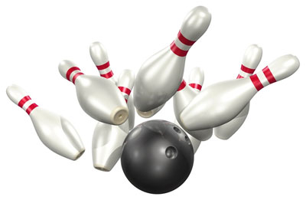
Hanging out with friend, Sam
Decide to go bowling
Sam claims his long-term average is 150
Over 3 games, Sam’s average is 40
Do you believe his claim?
Don’t believe him

Slide 5

What if…
Over 3 games Sam’s average is 140
Do you believe his average is 150?
More likely to believe him
Assume there is some reason he had a bit of a bad day
At point between 40 and 140 would you believe Sam’s claim?
This is quite subjective

Slide 6
Believing or Rejecting Sam’s Claim
In your mind, you have some cut-off score for Sam
Maybe as low as 120 – he’s just having a bad day
Maybe as high as 180 – otherwise he’s falsely modest
Based on the assumption that the claim of 150 is true
If a sample outcome falls outside the range of possibilities
REJECT Sam’s claim

Slide 7
Distribution of Bowling Scores
Rejection Region
Rejection Region
Prob. of 40 if 150 is his average
40
120
150
180
Notes:
This is a probability density function.
Assuming Sam’s claim is correct, for each possible bowling score there is an associated probability of Sam’s scoring that value
For scores around 150, the probability is quite high
For scores far away from 150, the probability is quite low

Slide 8
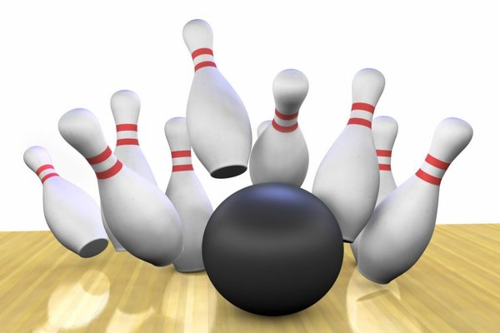
Now, you go bowling with Mum
Mum claims her long-term average is 150
Over 3 games, Mum’s average is 40
Do you believe her claim?
Chances are you don’t want to call Mum a liar if she’s just having a bad day
What to do?
Use lower cut-off value
Now 20 instead of 120

Slide 9
Smaller Rejection Region for Mum
Rejection Region
Rejection Region
Prob. of 40 if 150 is his average
20
40
150
280
Notes:
This is a probability density function.
Assuming Mum’s claim is correct, for each possible bowling score there is an associated probability of her scoring that value
For scores around 150, the probability is quite high
For scores far away from 150, the probability is quite low
Because we want to be really sure Mum is lying
Use a smaller rejection region

Slide 10
Key STEPS in Hypothesis Testing 1. Set up HYPOTHSESIS –Null & Alternative 2. Get the SAMPLE or TEST STATISTIC (e.g. t, z, or Chi-sq) 3. Find the p- value or critical value from tables. 4. Compare Sample Value with table & Conclude

Slide 11
Key Components
Null hypothesis - Claim
p-value (Significance)
Claim we are trying to verify
Sam claims his average is 150
Alternative Hypothesis
What we assume if Null hypothesis is rejected
Sam’s average is not 150
Sample (or test) statistic
From our evidence
Sam bowled an average of 40
Decision rule: α
to reject the claim
For Sam this was 120Cut-off value when we decide
How sure you want to be – what is the size of the rejection region
Smaller level for Mum than Sam
Likelihood of experimental results, if claim is true
Likelihood that Sam bowls 40 if 150 is his average – from density function
Critical value

Slide 12
2 Approaches
Determine our test statistic (experimental or survey results)
Option 1: Compare to a critical (cut-off) value
Determined from a model of probabilities for the statistic used
Option 2: Find its p-value and compare it to α (rejection region)
Determined from the distribution of the statistic used

Slide 13
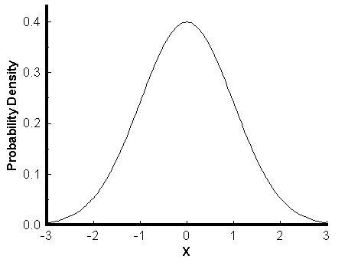
Area Under the Curve?

Slide 14
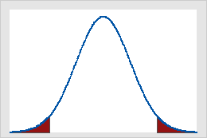
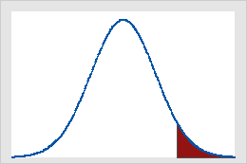
Rejection Regions for t-tests
Two-tail test
One-tail test
Sum of 2 red areas = α
Red area = α
Notes:
Two-tailed hypothesis
Is one where you have predicted that there will be a relationship between variables or a difference between conditions, but you have not predicted the direction of the relationship between the variables or the difference between the conditions. It is also called a bi-directional hypothesis.
One-tailed hypothesis
Is one where you have specified the direction of the relationship between the variables or the difference between two conditions. It is also called a directional hypothesis.

Slide 15
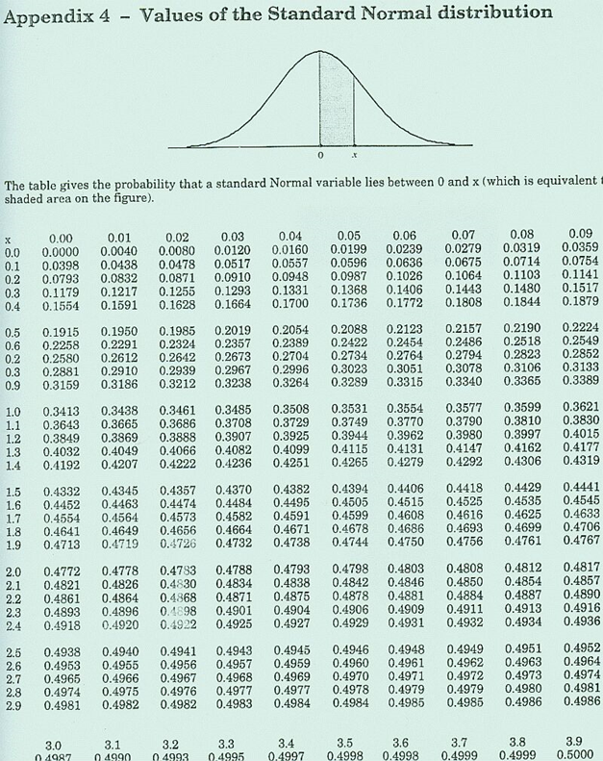
Finding the Critical Value
Total = 1
- .5
- .025 ( α = .05)
= .4750
Look for .4750 (shaded area)
Critical Value = 1.96
Notes:
Here is an example of the model of probabilities for the normal distribution.
This would be used for a Z statistic.

Slide 16
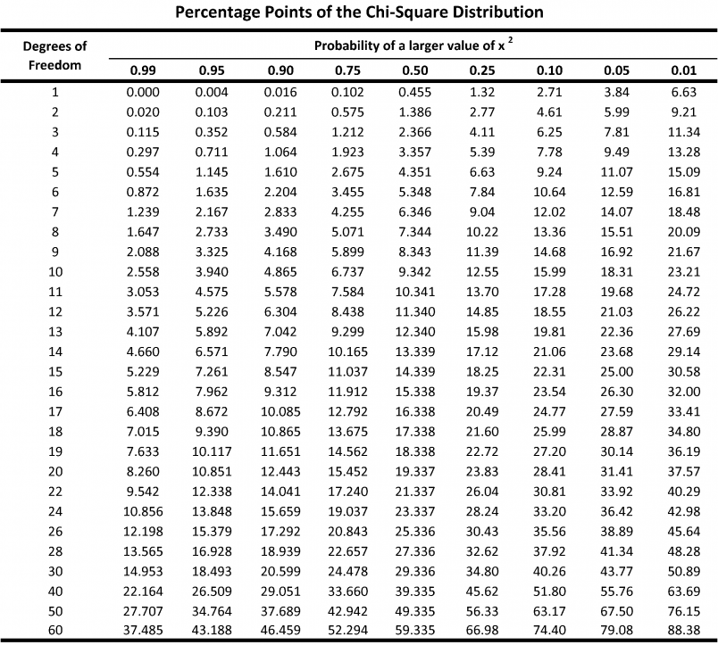
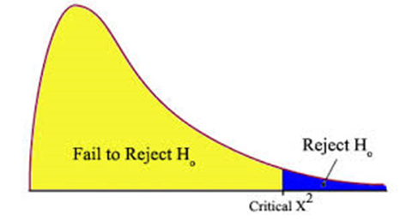
Chi-Square Distribution
Assume α = .05
Degrees of Freedom = 9
Critical value = 16.92
Notes:
Here is another example of the model of probabilities
This is for the Chi-square statistic.

Slide 17
P-value & Chi-Square Distribution
Critical Value
Test Statistic
Area under the curve to the right of the critical value is = α
Area under the curve to the right of the test statistic is = p-value
0
2
4
6
8
10
12
14
16
18
20
22
24
26
28
^{χ2}

Slide 18
Decision Rules
If test statistic is > critical value
Test statistic is right of the critical value
Reject H₀
α is greater than the p-value
Reject H₀
If p-value < α

Slide 19
P-value & Chi-Square Distribution
Test Statistic
Critical Value
Area under the curve to the right of the test statistic is = p-value
Area under the curve to the right of the critical value is = α
0
2
4
6
8
10
12
14
16
18
20
22
24
26
28
^{χ2}

Slide 20
Decision Rules
If test statistic is < critical value
Test statistic is left of the critical value
Do not reject H₀
α is less than the p-value (in the unshaded region)
Do not reject H₀
If p-value > α

Slide 21
Typical Hypothesis Testing Procedure
1) Specify Null and Alternative Hypotheses after analyzing the research problem
2) Choose appropriate statistical test, considering research design, and sampling distribution for the test statistic
3) Specify the significance level (alpha) for the problem being investigated (decision rule)
6) Compare the obtained probability with the specified significance level, reject or do not reject the null hypothesis on the basis of the comparison
4) Compute the value of the test statistic from collected data that is appropriate for the sampling distribution
5) Determine probability of the test statistic under the null hypothesis using the sampling distribution in step 2 (p-value)
Notes:
A null hypothesis is a statement of the status quo, one of no difference or no effect. If the null hypothesis is not rejected, no changes will be made.
An alternative hypothesis is one in which some difference or effect is expected. Accepting the alternative hypothesis will lead to changes in opinions or actions.
The null hypothesis refers to a specified value of the population parameter (e.g., mean, standard deviation, correlation), not a sample statistic (e.g., average, sample standard deviation, r).
The test statistic measures how close the sample has come to the null hypothesis.
The test statistic often follows a well-known distribution, such as the normal, t, or chi-square distribution.

Slide 22
Classification of Hypothesis Tests
Hypothesis Tests
Tests of Association
Tests of Differences
Single Mean
2 Means with dependent samples
2 Means with independent samples
More than 2 means
Chi-Square

Slide 23
Lets consider associations between variables Association -Chi-square

Slide 24
Cross Tabulation
? ..Are service quality perceptions associated with gender?
Cell values are counts (of people)
Finds associations or relationships, not causation
Hypothesis
H₀: There is no association between the variables
i.e. variables are independent
H₁: There is an association

Slide 25
Cross Tabulations Next 2 slides are for illustration only
Behavior
(Dependent) Variable
 | Overall Service Quality
 | 1 | 2 | 3 | 4 | 5 | 6 | 7 | 8 | 9 | 10 | Total
Male | 3 | 4 | 4 | 2 | 8 | 4 | 15 | 28 | 36 | 33 | 137
Female | 3 | 1 | 3 | 2 | 16 | 10 | 9 | 17 | 25 | 40 | 126
Total | 6 | 5 | 7 | 4 | 24 | 14 | 24 | 45 | 61 | 73 | 263
Descriptor (Independent) Variable
Notes:
Commonly called ‘Crosstabs’
Most common data analysis tool in market research
Easy to understand
Frequency distribution with >1 variables
Used for nominal data
Convert ordinal, interval, and ratio to nominal
Typically for cross tabulations
Descriptor variables (demographic, etc.)
Behavioral variables
Usually interested in percent of descriptor variable
Descriptor Variables
Used to identify or categorize individuals
Demographic (Geo-demographic)
Socioeconomic
Personality
Psychographics
Can be thought of as independent variables
Behavioral Variables
Behaviors of interest to us, typically towards our brand, company, or industry
Brand choice
Attitude
Familiarity
Likelihood of purchase
Frequency of purchase
Can be thought of as dependent variables

Slide 26
What are the Expected Frequencies?
 | Overall Service Quality
 | 1 | 2 | 3 | 4 | 5 | 6 | 7 | 8 | 9 | 10 | Total
Male | 6*.521 | 5*.521 | 7*.521 | 4*.521 | 24*.521 | 14*.521 | 24*.521 | 45*.521 | 61*.521 | 73.521 | 137 52.1%
Female | 6*.479 | 5*.479 | 7*.479 | 4*.479 | 24*.479 | 14*.479 | 24*.479 | 45*.479 | 61*.479 | 73*.479 | 126 47.9%
Total | 6 2.3% | 5 1.9% | 7 2.7% | 4 1.5% | 24 9.1% | 14 5.0% | 24 9.1% | 45 17.1% | 61 23.2% | 73 27.8% | 263 100%

Slide 27
χ² Statistic

Slide 28
What is Calculated χ²?
Assume α = .05
Degrees of Freedom = (10 – 1)*( 2 – 1) = 9
Area = .95
χ² < 16.92 then do not reject H₀
Area = .05
χ² > 16.92 then reject H₀
0
2
4
6
8
10
12
14
16
18
20
22
24
26
28
^{χ2}
Critical value = 16.92

Slide 29
χ² Test
Critical χ² = 16.92
α = .05
Degrees of freedom = (10 – 1)*( 2 – 1) = 9
Test statistic: χ² = 13.59
Where is it?
Do we reject H₀?
What is our managerial conclusion?
Notes:
Do not reject null hypothesis
Service quality perception is not associated with gender
No need to worry that men (versus women) perceive better or worse service

Slide 30
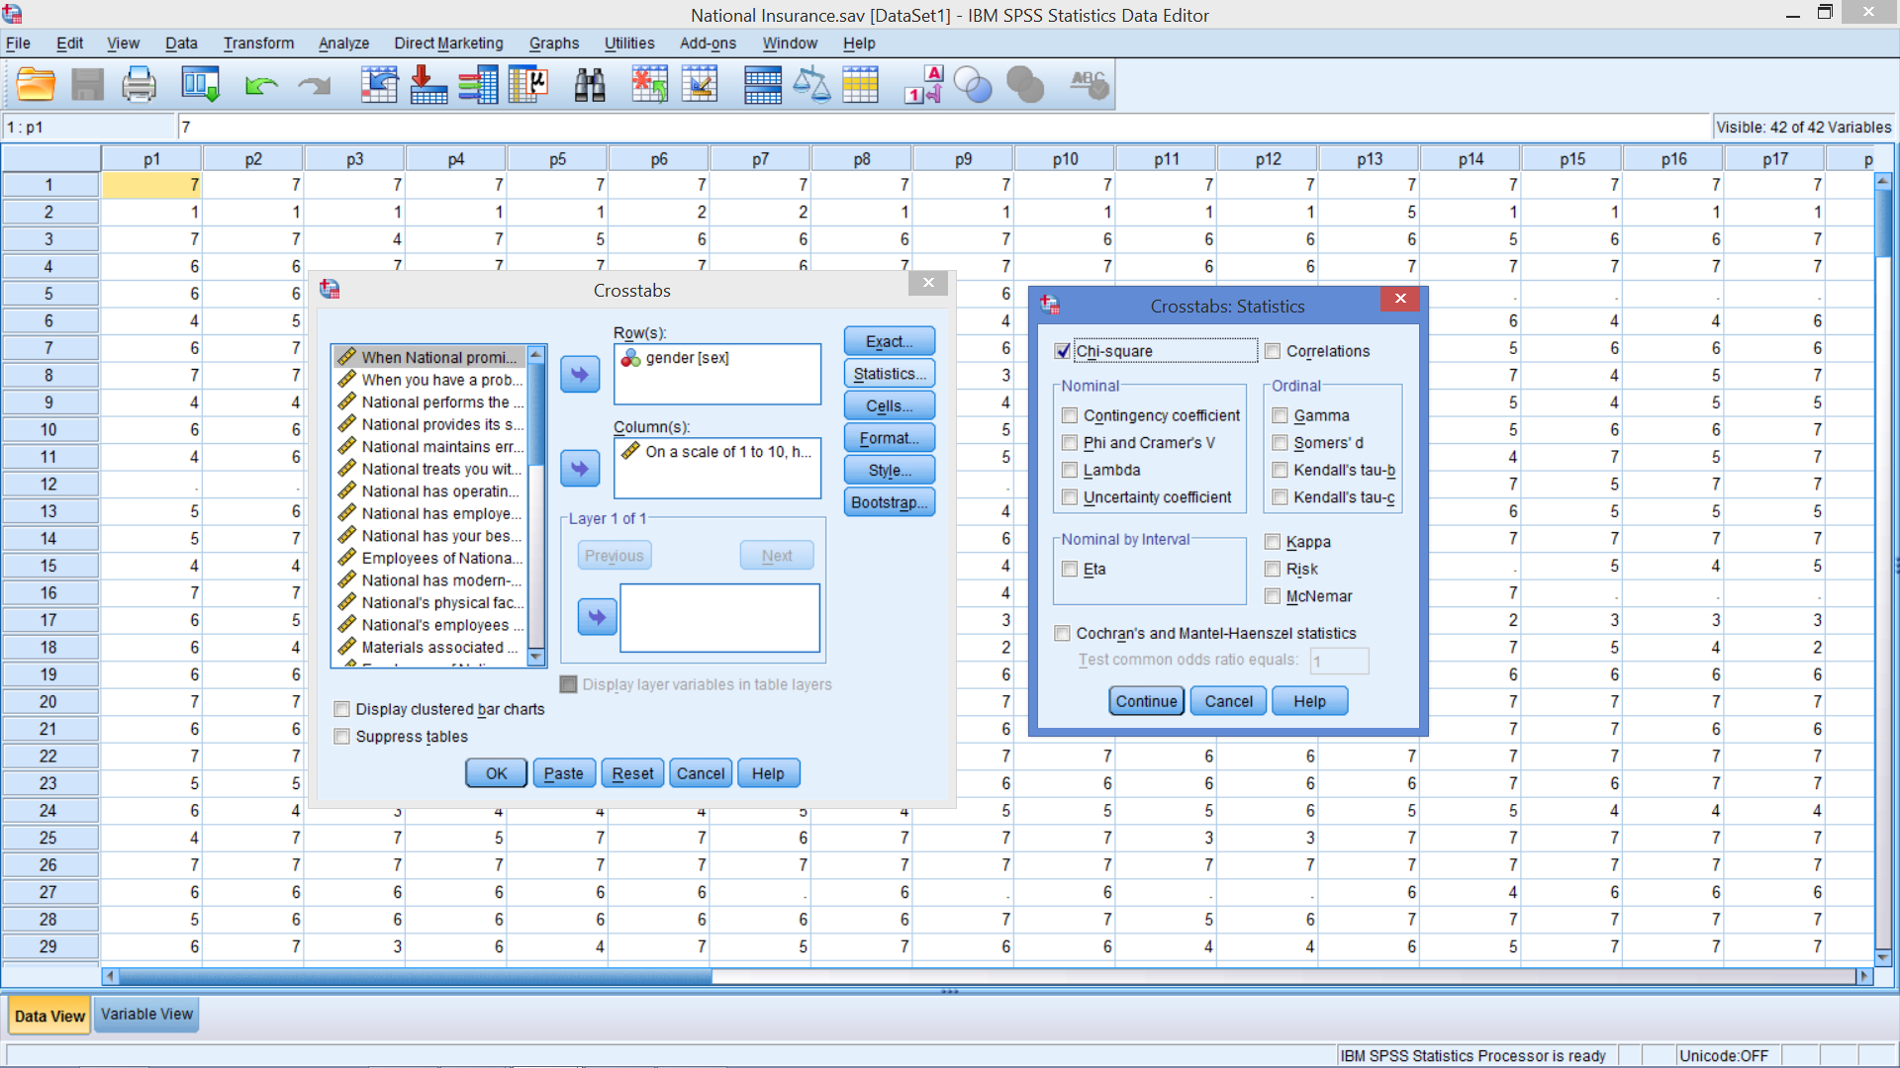
Chi-Square Test
Notes:
From the Cross Tab dialog box select Statistics
Tick box for Chi Square

Slide 31
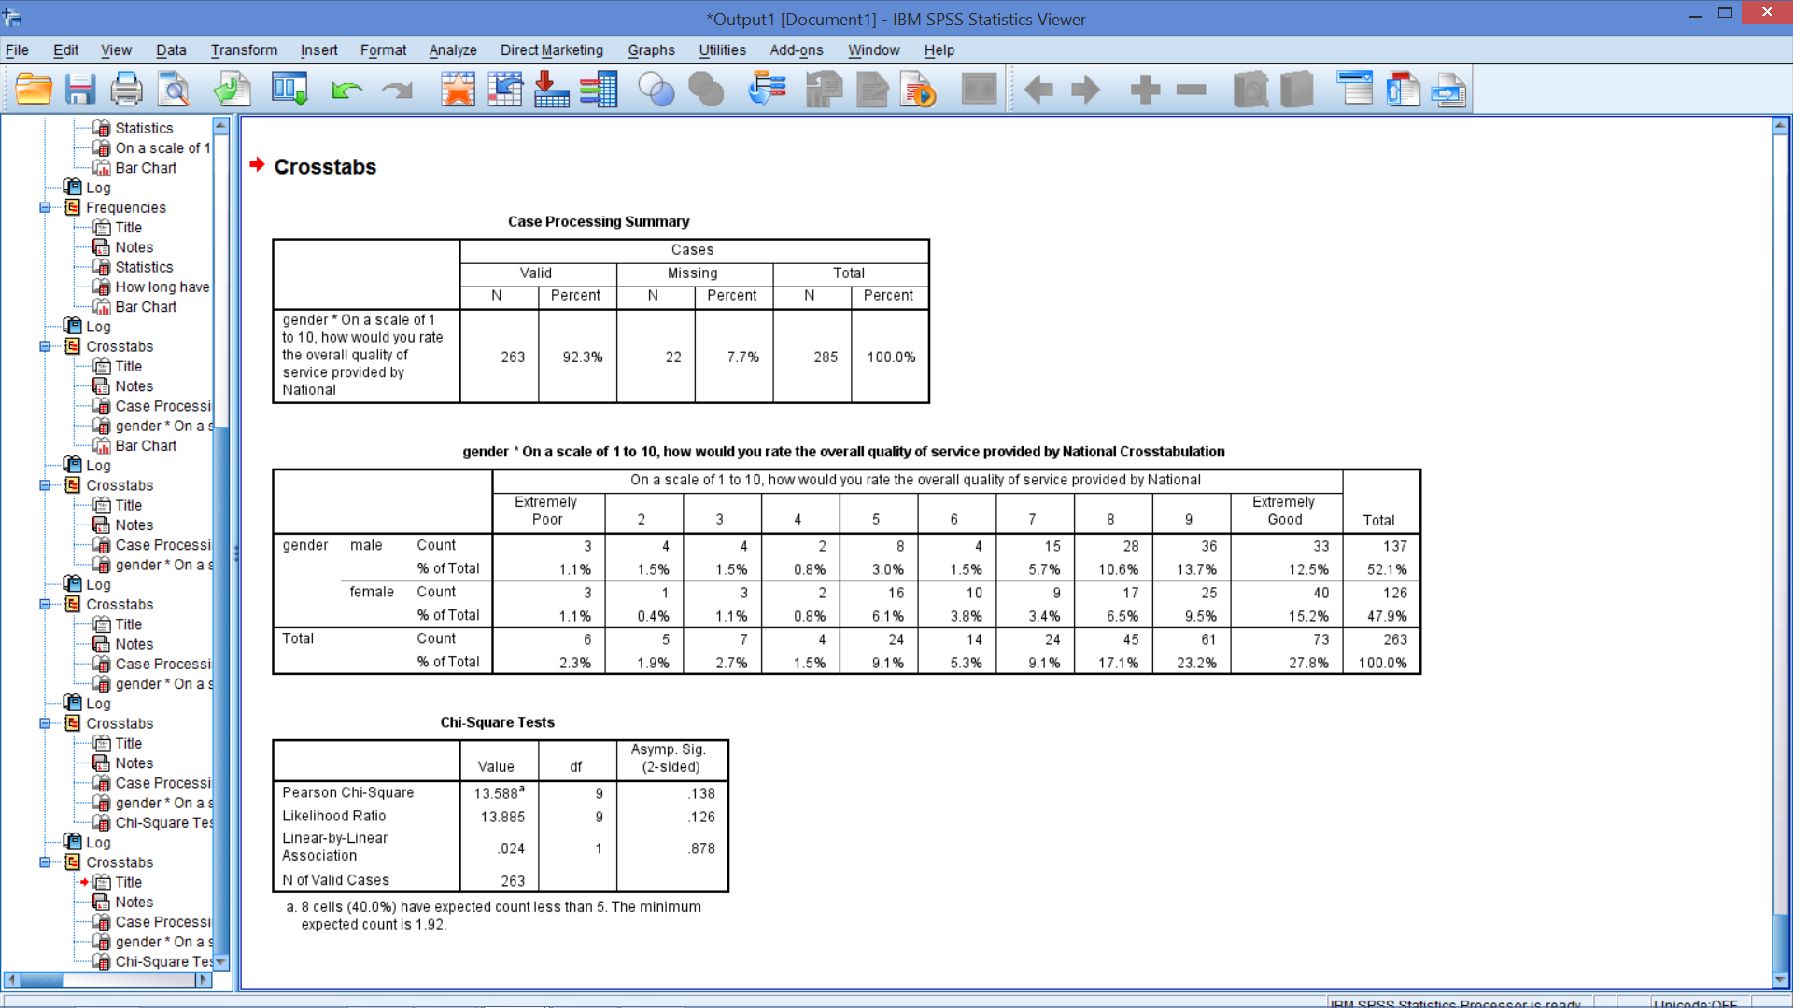
Cross tab with Chi-Square Test
p-value
Test statistic
Notes:
Note that sig (significance) in SPSS is the same as p-value in Excel

Slide 32
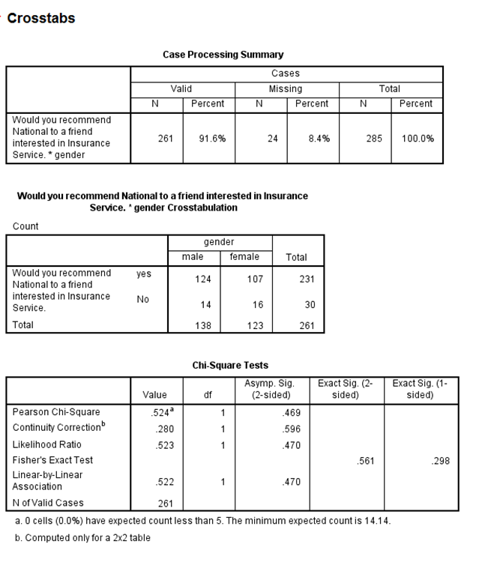
Is Gender Related to Willingness to Recommend National (rec)?

Slide 33
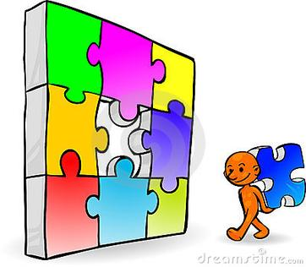
Sample Problem 3

Slide 34
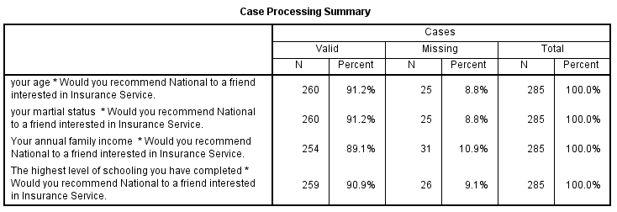
Valid Data

Slide 35
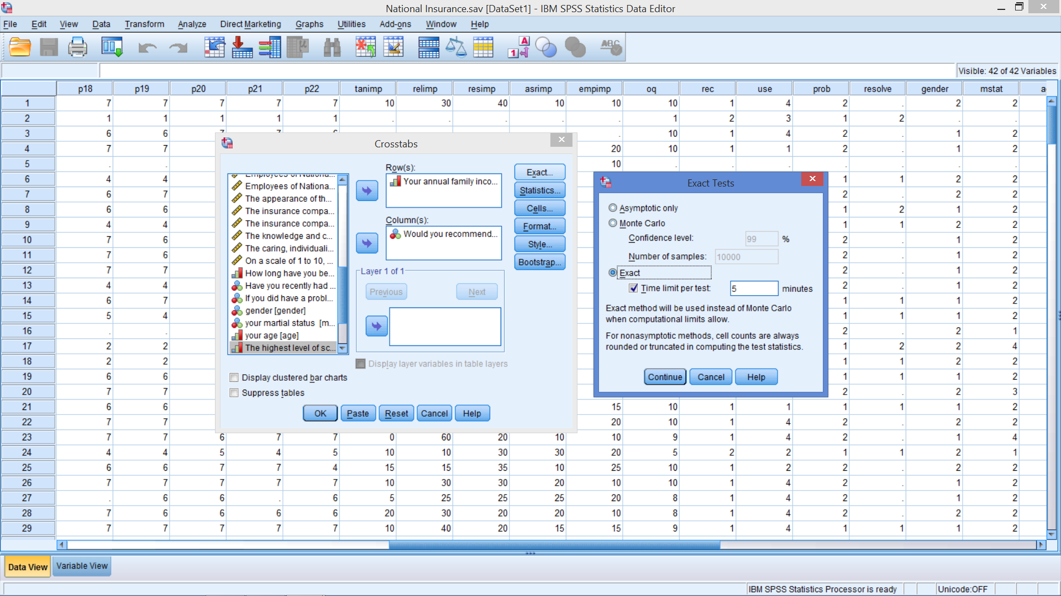
Rerun Income w/ Exact Test
Notes:
Exact Tests provides two additional methods for calculating significance levels for the statistics available through the Crosstabs and Nonparametric Tests procedures. These methods, the exact and Monte Carlo methods, provide a means for obtaining accurate results when your data fail to meet any of the underlying assumptions necessary for reliable results using the standard asymptotic method. Available only if you have purchased the Exact Tests Options.
Asymptotic results obtained from small datasets or sparse or unbalanced tables can be misleading. Exact tests enable you to obtain an accurate significance level without relying on assumptions that might not be met by your data. For example, results of an entrance exam for 20 fire fighters in a small township show that all five white applicants received a pass result, whereas the results for Black, Asian and Hispanic applicants are mixed. A Pearson chi-square testing the null hypothesis that results are independent of race produces an asymptotic significance level of 0.07. This result leads to the conclusion that exam results are independent of the race of the examinee. However, because the data contain only 20 cases and the cells have expected frequencies of less than 5, this result is not trustworthy. The exact significance of the Pearson chi-square is 0.04, which leads to the opposite conclusion. Based on the exact significance, you would conclude that exam results and race of the examinee are related. This demonstrates the importance of obtaining exact results when the assumptions of the asymptotic method cannot be met. The exact significance is always reliable, regardless of the size, distribution, sparseness, or balance of the data.

Slide 36
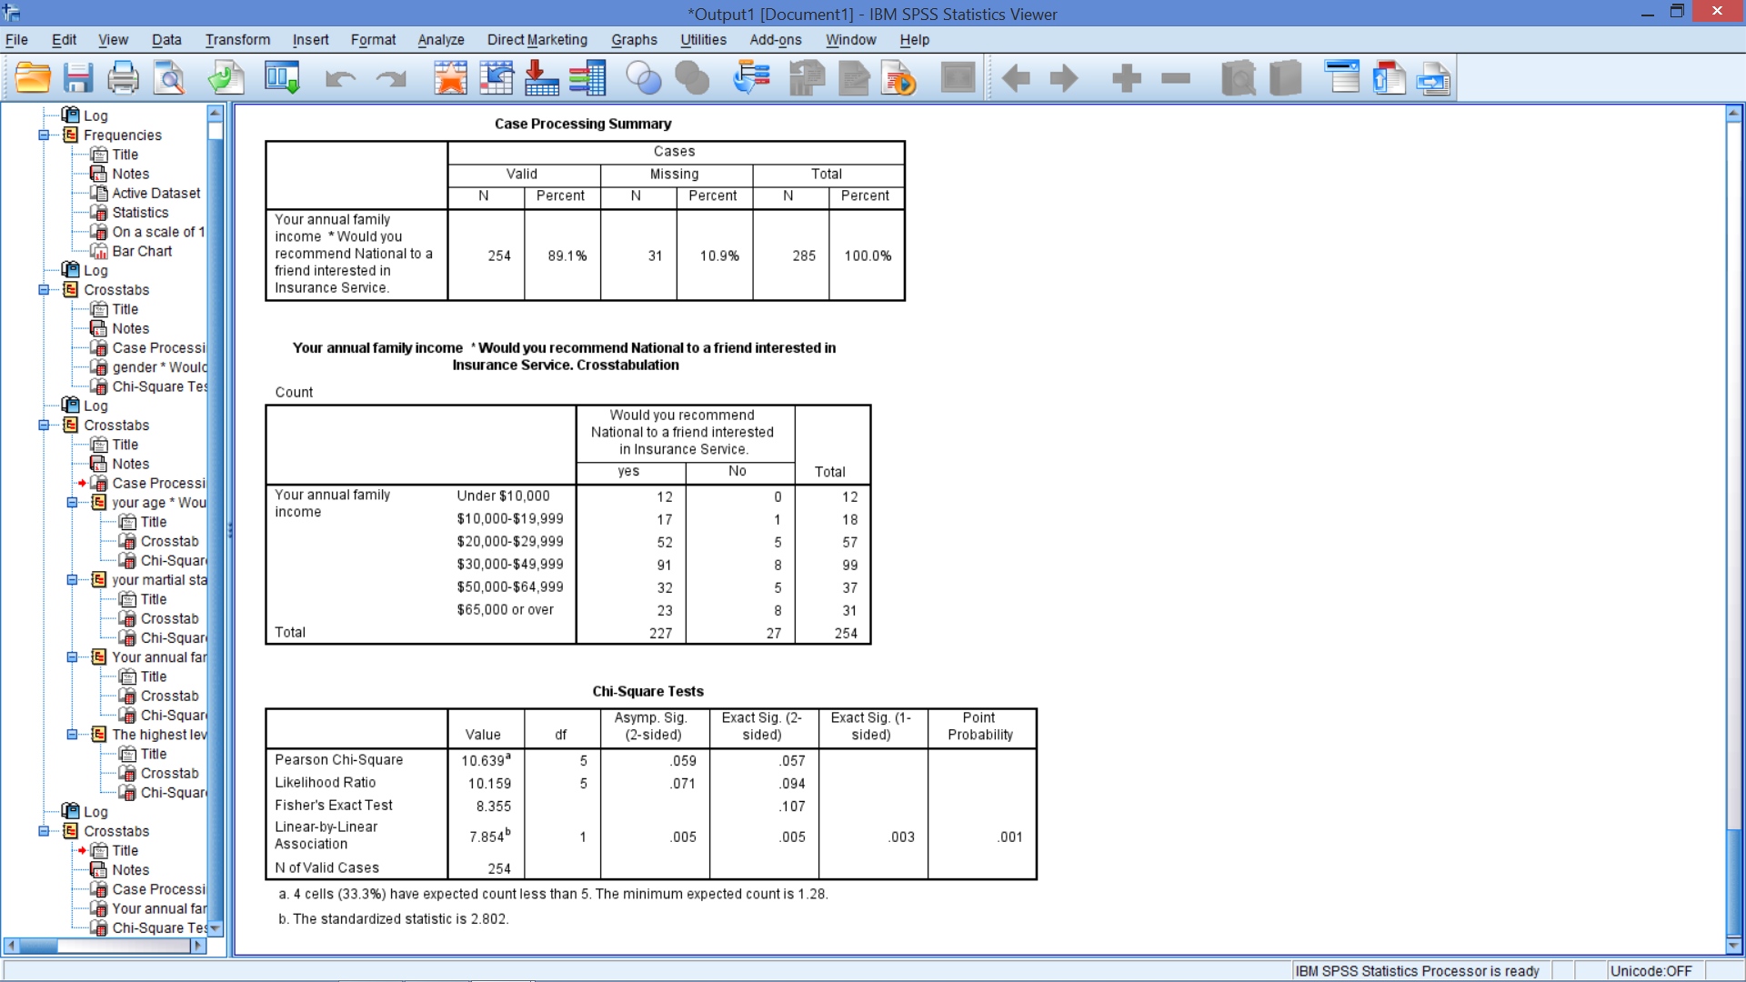
Similar Inference

Slide 37
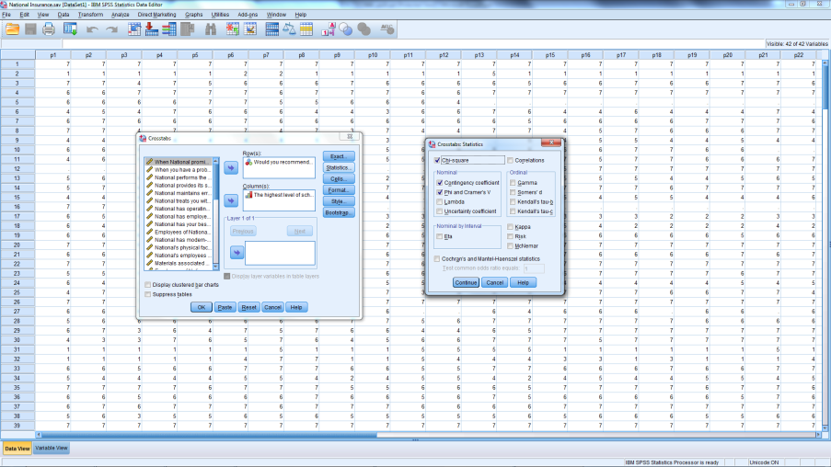
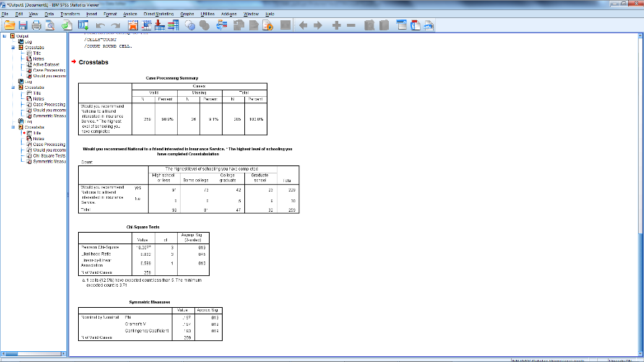
Additional Statistics: Strength of the Association
Notes:
These statistics measure the strength of the association between the variables. They can be obtained by ticking the appropriate boxes on the Statistics menu from the Cross Tab dialog box.
The phi coefficient (Ф) is used as a measure of the strength of association in the special case of a table with two rows and two columns (a 2 x 2 table).
The phi coefficient is proportional to the square root of the chi-square statistic
$φ=\sqrt{\frac{x^{2}}{n}}$
It takes the value of 0 when there is no association, which would be indicated by a chi-square value of 0 as well; When the variables are perfectly associated, phi assumes the value of 1 and all the observations fall just on the main or minor diagonal.
While the phi coefficient is specific to a 2 x 2 table, the contingency coefficient (C) can be used to assess the strength of association in a table of any size.
The contingency coefficient varies between 0 and 1.
$C=\sqrt{\frac{x^{2}}{x^{2}+n}}$
The maximum value of the contingency coefficient depends on the size of the table (number of rows and number of columns). For this reason, it should be used only to compare tables of the same size.
Cramer's V is a modified version of the phi correlation coefficient and is used in tables larger than 2 x 2
$V=\sqrt{\frac{φ^{2}}{min(\left(r−1\right),(c−1))}}$

Slide 38
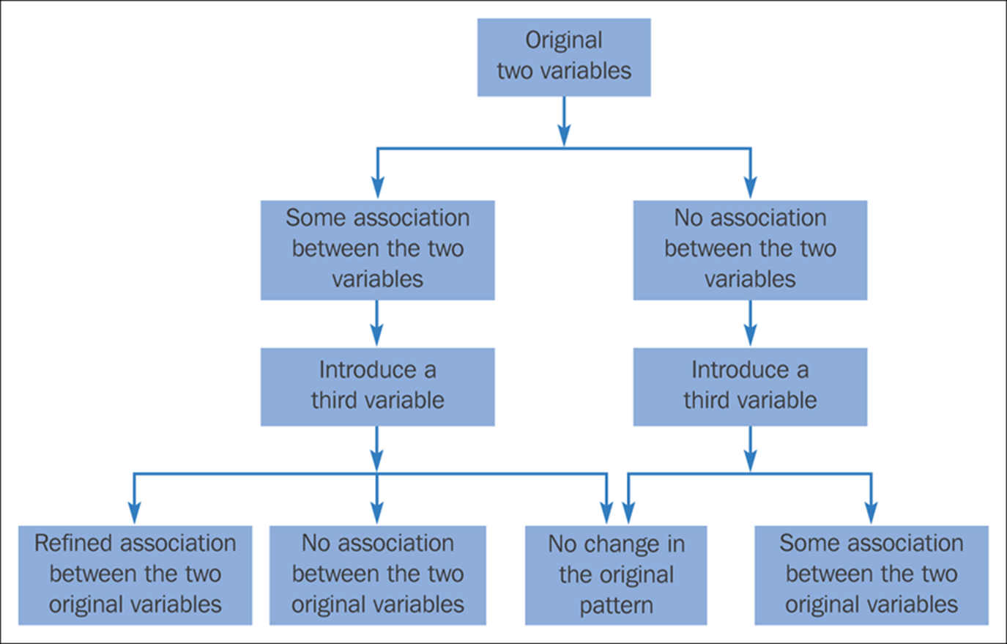
Figure 18.7

Slide 39
Means t-tests and ANOVA

Slide 40
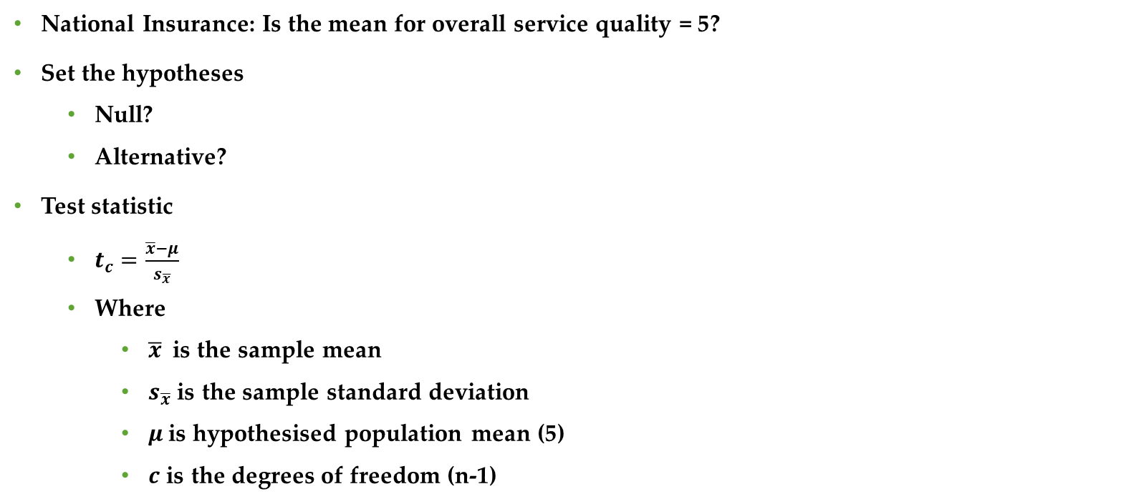
Single Mean
National Insurance: Is the mean for overall service quality = 5?
Set the hypotheses
Null?
Alternative?
Test statistic
$t_{c}=\frac{\overline{x}−μ}{s_{\overline{x}}}$
Where
$\overline{x}$is the sample mean
$s_{\overline{x}}$ is the sample standard deviation
$μ$is hypothesised population mean (5)
$c$ is the degrees of freedom (n-1)
Notes:
Null: Mean = 5
Alternative: Mean ≠ 5
The correct sampling distribution for tests of means, is the t-distribution. However, when sample sizes are greater than 25, the Z-statistic is often used because the t-distribution closely resembles the standard normal curve.

Slide 41
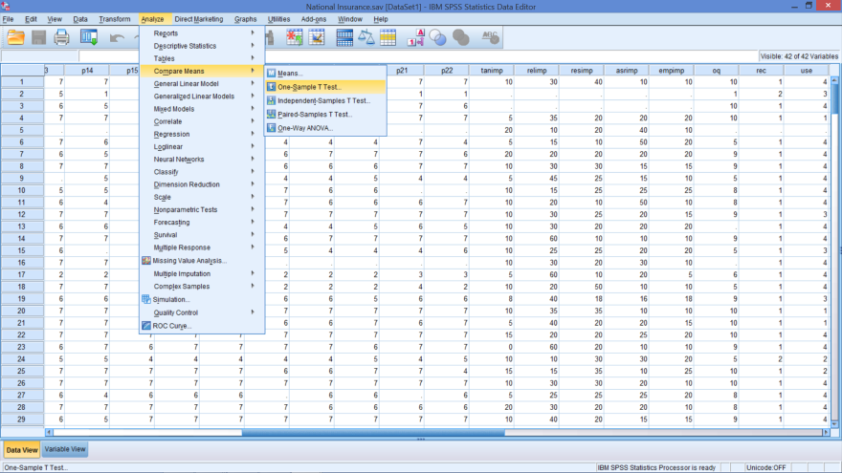
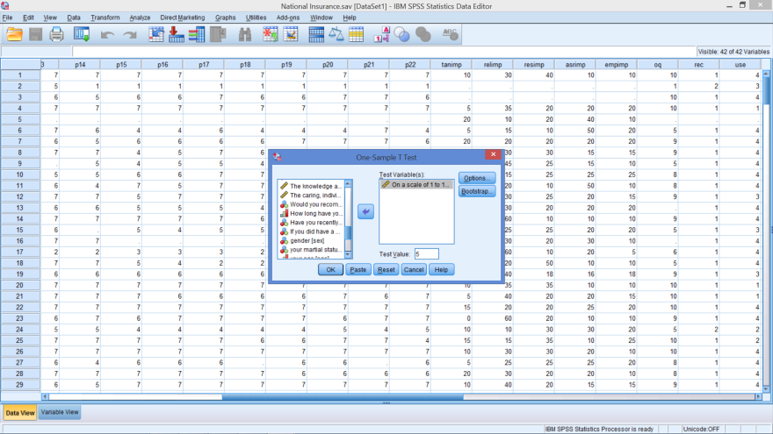
SPSS Specifications
Notes:
Analyse
Compare Means
One-sample t-test
In dialog box:
Insert Service quality (On a scale of 1 to 10…) in Test variables box
Insert 5 into the Test value box

Slide 42
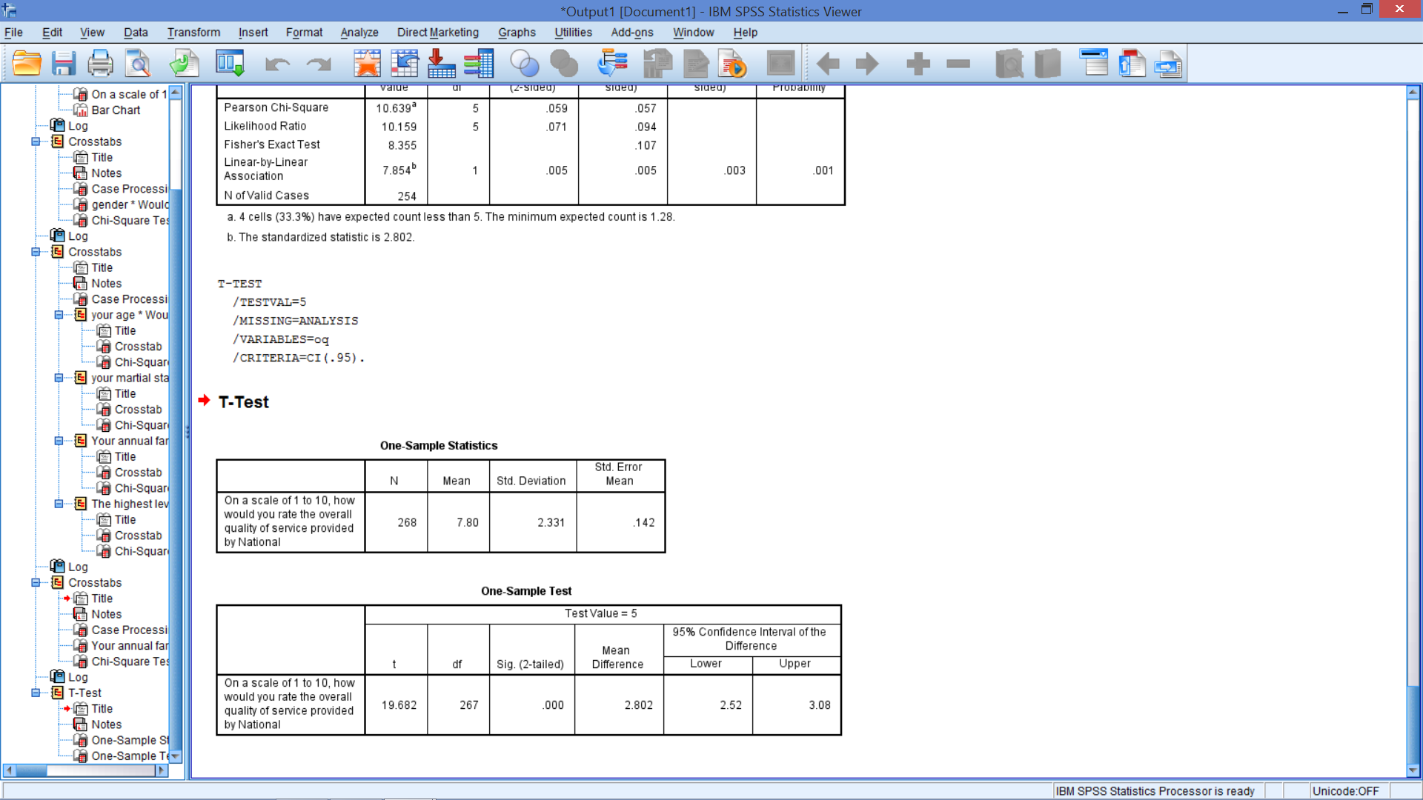
Output: Reject?

Slide 43
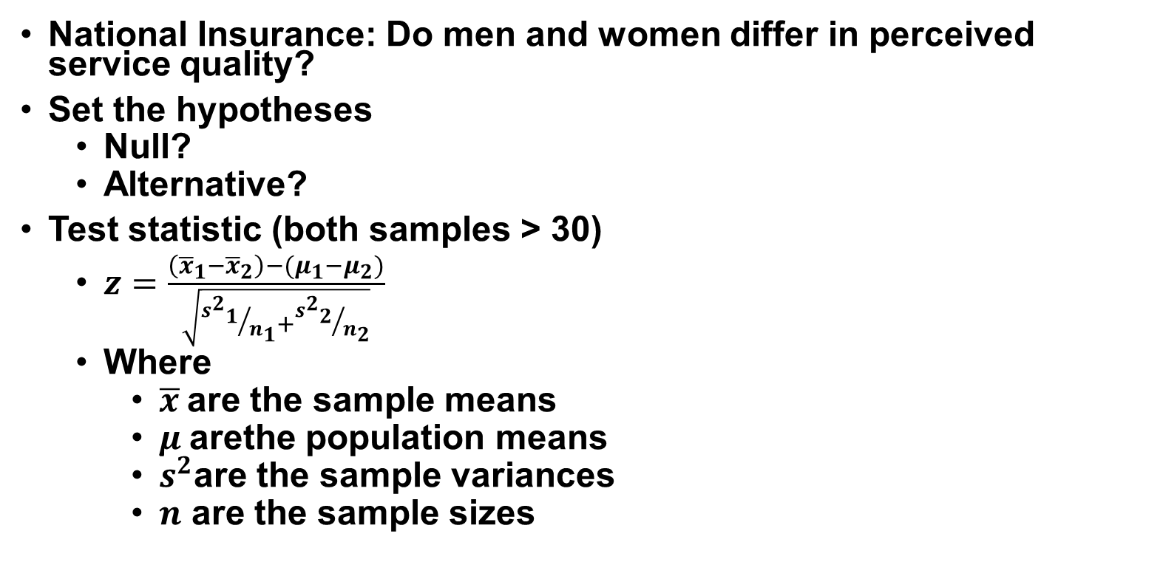
2 Means – Independent Samples
National Insurance: Do men and women differ in perceived service quality?
Set the hypotheses
Null?
Alternative?
Test statistic (both samples > 30)
$z=\frac{\left({\overline{x}}_{1}−{\overline{x}}_{2}\right)−(μ_{1}−μ_{2})}{\sqrt{{{s^{2}}_{1}}/{n_{1}}+{{s^{2}}_{2}}/{n_{2}}}}$
Where
$\overline{x}$are the sample means
$μ$arethe population means
$s^{2}$are the sample variances
$n$ are the sample sizes
Notes:
Null:
Mean for men = Mean for women
Or: Mean for men – Mean for women = 0
Alternative:
Means are not equal
Or: Difference in the means ≠ 0

Slide 44
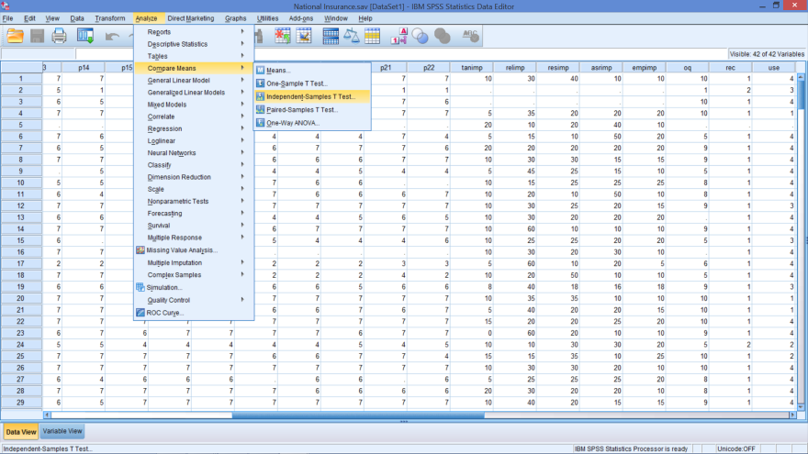
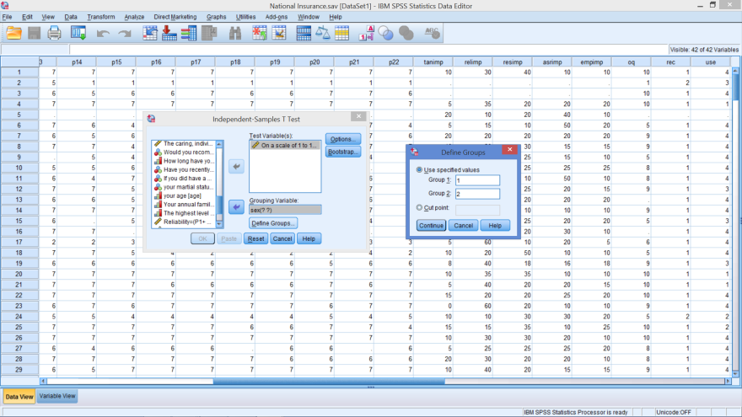
SPSS Specifications
Notes:
Analyse
Compare Means
Independent samples t-test
In dialog box:
Insert Service quality (On a scale of 1 to 10…) in Test variables box
Insert gender (sex) into the grouping variable box
Then click on Define Groups
Group 1 = 1 (Male)
Group 2 = 2 (Female)
This must match variable view information

Slide 45
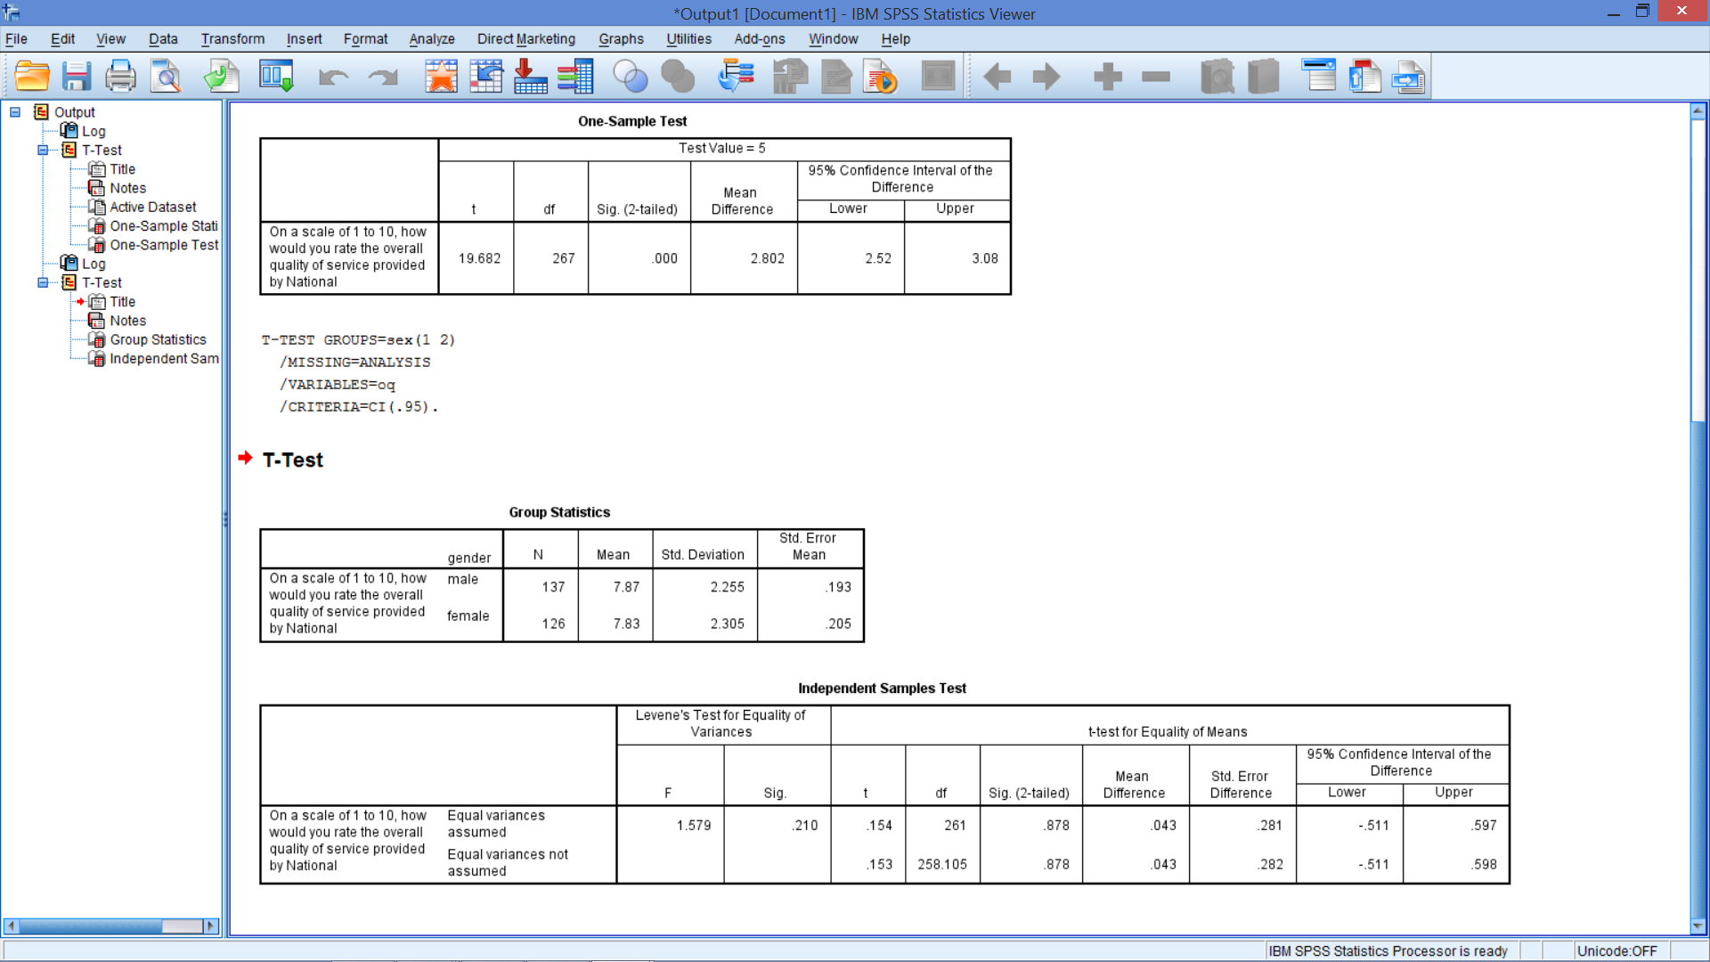
Output
Which t-test is appropriate?

Slide 46
Look at F test Output
H₀: Variances are equal
H₁: Variances are not equal
Sig. for F > .05 → Do not reject H₀
Use t-test for equal variances assumed (top one)

Slide 47
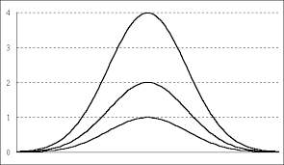
Same Mean Different Variance

Slide 48
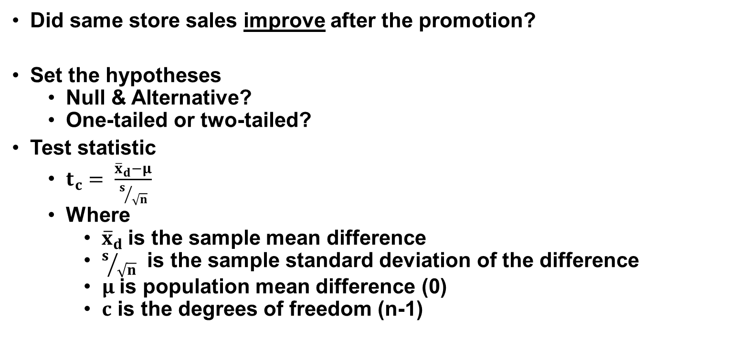
2 Means – Dependent Samples
Did same store sales improve after the promotion?
Set the hypotheses
Null & Alternative?
One-tailed or two-tailed?
Test statistic
$t_{c}= \frac{{\overline{x}}_{d}−μ}{s/{\sqrt{n}}}$
Where
${\overline{x}}_{d}$is the sample mean difference
$s/{\sqrt{n}}$ is the sample standard deviation of the difference
$μ$is population mean difference (0)
$c$ is the degrees of freedom (n-1)
Notes:
Not independent samples because we are testing the same shops
Null:
Mean for before promotion = Mean after the promotion
Or: Mean for difference = Mean for before – Mean for after = 0
Alternative:
Means are not equal
Or: Difference in the means ≠ 0

Slide 49
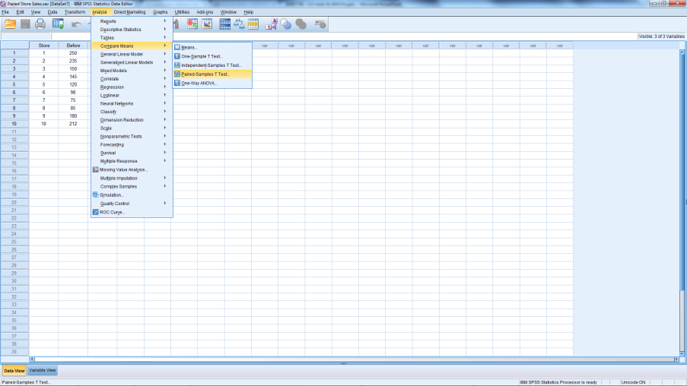
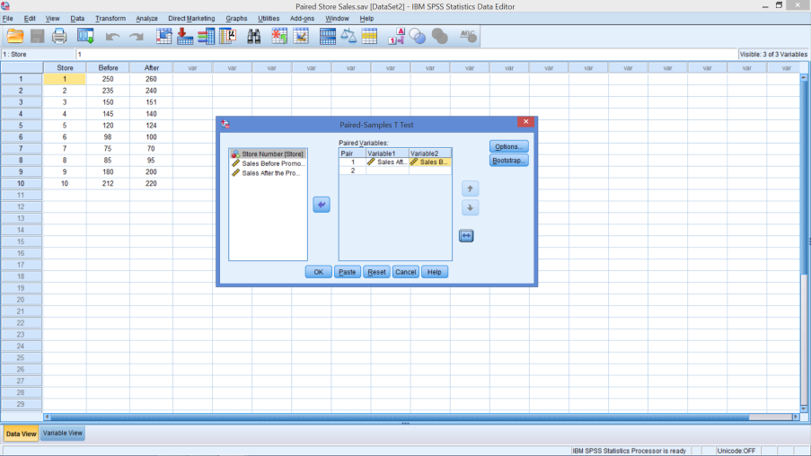
Paired Sample Test
Open Paired Store Sales - SPSS
Notes:
Analyse
Compare Means
Paired samples t-test
In dialog box:
For Pair 1:
Insert After Sales into column 1 (we hope this is higher)
Insert Before Sales into column 2
Could do other pairs if more data

Slide 50
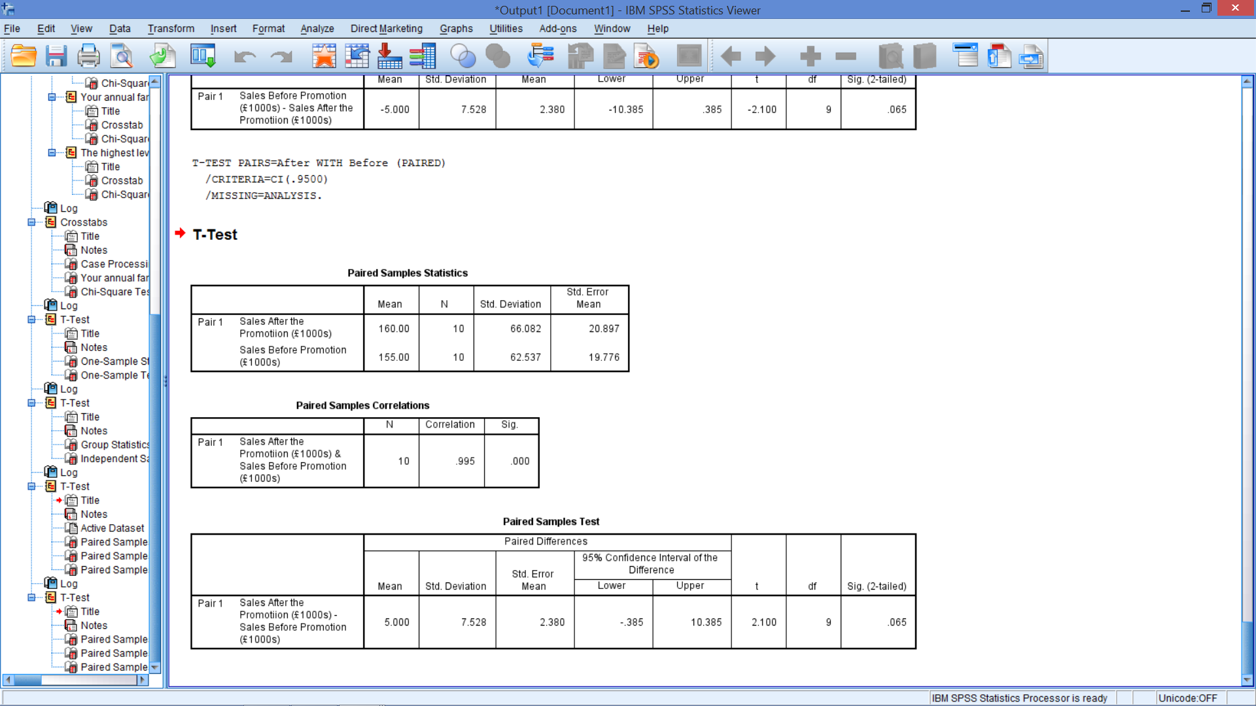
Reject or Do Not Reject?

Slide 51
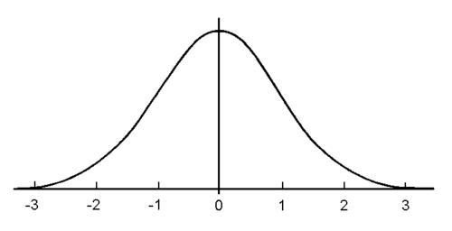
One-tailed Test: Is p-value < α?
We’re looking at a one-tailed test with area = .05; The area to the right is only .0325
Sum of both areas = .065

Slide 52
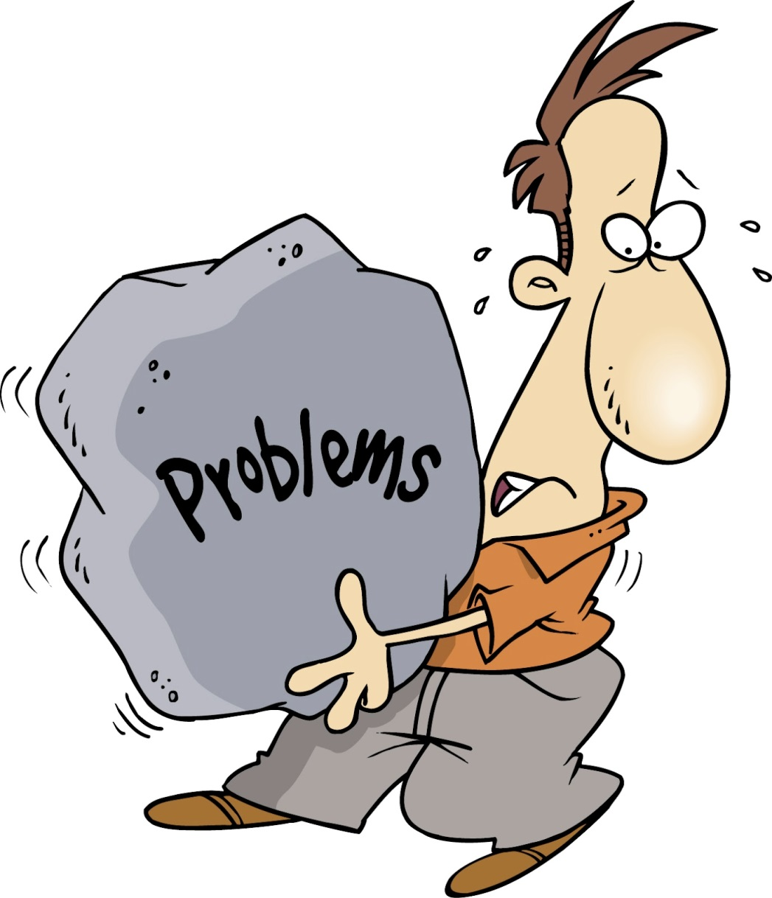
Sample Problems 4 & 5

Slide 53
Problem 4
How are the variables coded?
Overall perception of service quality?
Perceptions of each of the 5 dimensions?
Recommending National to a Friend?
What type of test:
One sample?
Independent samples?
Paired sample?

Slide 54
Review
What makes the test statistic and critical value…
Similar?
Different?
What makes the p-value & α …
Similar? Both measure area under the curve
Different? One measure area from test statistic (p-value) and the other measures the area from the critical value (α)
Both fall on a distribution
One comes from data, the other from the distribution of the statistic
Notes:
What makes the test statistic and critical value…
Similar?
Both fall on a distribution
Different?
One comes from data, the other from the distribution of the statistic
What makes the p-value & α …
Similar?
Both measure area under the curve
Different?
One measure area from test statistic (p-value) and the other measures the area from the critical value (α)

Slide 55
Classification of Hypothesis Tests
Hypothesis Tests
Tests of Association
Tests of Differences
Single Mean
2 Means with dependent samples
2 Means with independent samples
More than 2 means
Chi-Square

Slide 56
One-Way Analysis of Variance
Do the various segments (urban vs. rural or men vs. women) differ in terms of the volume of product consumed?
Do the brand evaluations of groups exposed to different commercials differ?
What is the effect of consumers' familiarity with the store (measured as high, medium, and low) on preference for the store?
Notes:
Marketing researchers are often interested in examining the differences in the mean values of the dependent variable for several categories of a single independent variable or factor.

Slide 57
Why ANOVA instead of t-tests?
Still looking at some variable of interest
Consumption, brand evaluation, preference
More flexible
Independent variable (IV) can have more than 2 categories
Every test has error (5%)
Do as few tests as possible
Dependent variable (DV) is metric

Slide 58
Setting Up the Problem Analysis of variance (ANOVA) is used as a test of means for two or more populations.
When to use ANOVA?
What are the hypotheses?
H₀: No difference in means between groups (IV)
H₁: At least one mean is different
DV is metric – Interval or ratio data
IV is categorical
Notes:
Analysis of variance (ANOVA) is used as a test of means for two or more populations.
The null hypothesis, typically, is that all means are equal.
Analysis of variance must have a dependent variable that is metric (measured using an interval or ratio scale).
There must also be one or more independent variables that are all categorical (nonmetric).
Categorical independent variables are also called factors.
A treatment is the same as a factor level.

Slide 59
Which Approach is Best? Open data file ‘computer sales’
Computer Sales
Situation
15 Salespeople
Randomly assigned to one of three approaches
Sales (£1000s) recorded
 | Selling Approach
Sales- person | A | B | C
1 | 15 | 19 | 28
2 | 17 | 17 | 25
3 | 21 | 17 | 22
4 | 13 | 25 | 31
5 | 12 | 30 | 34

Slide 60
The next few slides are showing the theoretical underpinning of the test. Degrees of Freedom
Sales-person | Selling Approach |  |  | Total Sample
 | A | B | C
1 | 15 | 19 | 28
2 | 17 | 17 | 25
3 | 21 | 17 | 22
4 | 13 | 25 | 31
5 | 12 | 30 | 34
Average | 15.6 | 21.6 | 28 | 21.73
3 numbers given such that their mean = 21.73
If one number = 15.6, there are infinite possibilities for other 2
If two numbers are provided, there is only 1 value available for the third such that the mean will be 21.73
2 degrees of freedom because once 2 numbers are set, we know the third
Notes:
Imagine a set of three numbers, whose mean is 21.73. There are lots of sets of three numbers with this mean, but for any set the bottom line is this: you can freely pick the first two numbers, any number at all, but the third (last) number is out of your hands as soon as you picked the first two. Say our first two numbers are 15.6 and 21.6, giving us a set of two freely picked numbers, and one number that we still need to choose, x: [15.6, 21.6, x]. For this set to have a mean of 21.73, we don’t have anything to choose about x. X has to be 28, because (15.6+21.6+28) / 3 is the only way to get to 21.73. So, the first two values were free to choose, the last value is set accordingly to get to a given mean. This set is said to have two degrees of freedom, corresponding with the number of values that were free to choose (that is, that were allowed to vary freely).
SS_{between}: Also denoted as SS_{x}, this is the variation in the dependent variable related to the variation in the means of the categories of X. This represents variation between the categories of X, or the portion of the sum of squares in Y related to the factors or treatments.
SS_{within}: Also referred to as SS_{error}, this is the variation in the dependent variable due to the variation within each of the categories of X. This variation is not accounted for by treatments.
SS_{Total}. Also denoted as SS_{Y}, this is the total variation in the dependent variable.

Slide 61
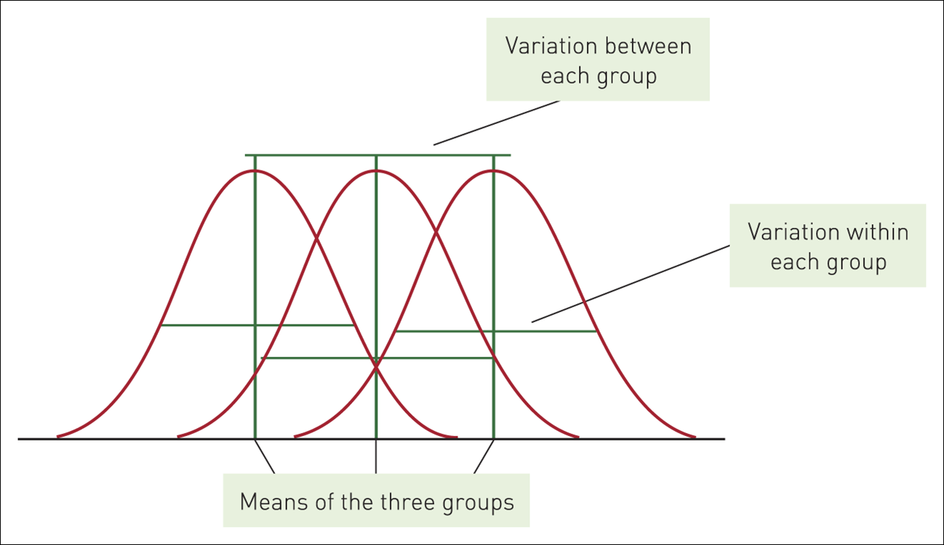
3-Group Comparison
Notes:
On the graph provided we have 3 means – one for each sales approach
The means could be different because
The approaches are truly different (what we are trying to learn)
Or because of the variation in the skills/experience of the sales people
What if it is a coincidence that all the best sales people are in one approach while the less experienced ones are together in another
Or, there is a big mixture of sales people in each strategy
Need to control for variances within the groups to see if the means are truly different

Slide 62
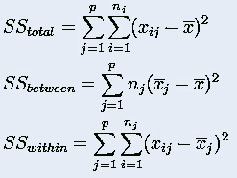
Decomposition of Variation: Theory One-Way ANOVA
Sales-person | Selling Approach |  |  | Total Sample
 | A | B | C
1 | 15 | 19 | 28
2 | 17 | 17 | 25
3 | 21 | 17 | 22
4 | 13 | 25 | 31
5 | 12 | 30 | 34
Average | 15.6 | 21.6 | 28 | 21.73
i = ith observation
j = jth category
p = number categories (3)
n_{j} = observations in jth category
Notes:
Ss_{between}: Also denoted as SS_{x}, this is the variation in the dependent variable related to the variation in the means of the categories of X. This represents variation between the categories of X, or the portion of the sum of squares in Y related to the factors or treatments. In this case, this is the variation between the approaches.
Ss_{within}: Also referred to as SS_{error}, this is the variation in the dependent variable due to the variation within each of the categories of X. This variation is not accounted for by treatments. In this case, this is the variation between sales people within each approach.
SS_{Total}. Also denoted as SS_{Y}, this is the total variation in the dependent variable.

Slide 63
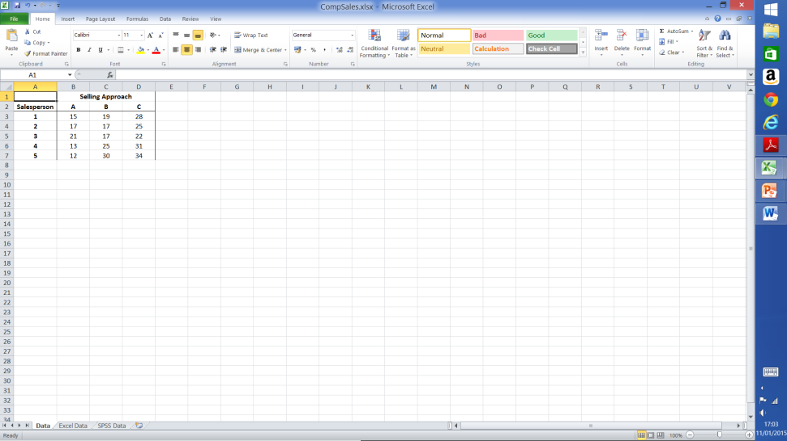
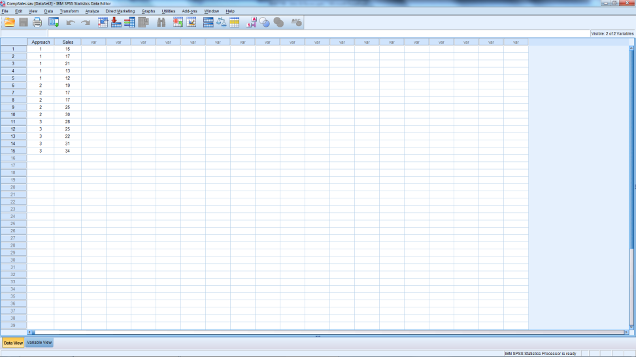
HOW TO RUN THE TEST Run Using Both Excel & SPSS
CompSales.sav
CompSales.xlx
Notes:
Notice that the input files are set up differently for different software.

Slide 64
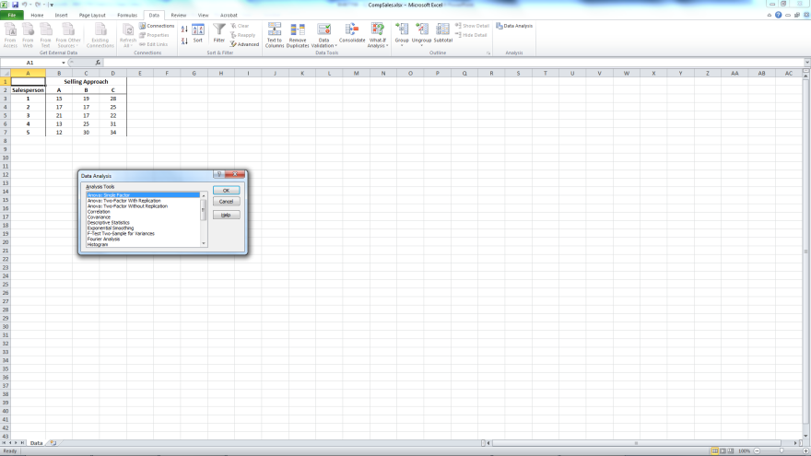
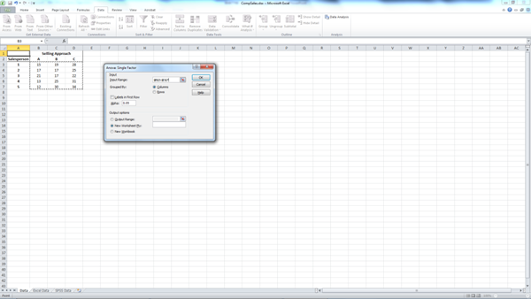
FYI only Dialog Boxes - Excel
Notes:
Data → Data Analysis
Anova: Single Factor
Input range: B2:D7
If row 2 is included – tick box for Labels in first row

Slide 65
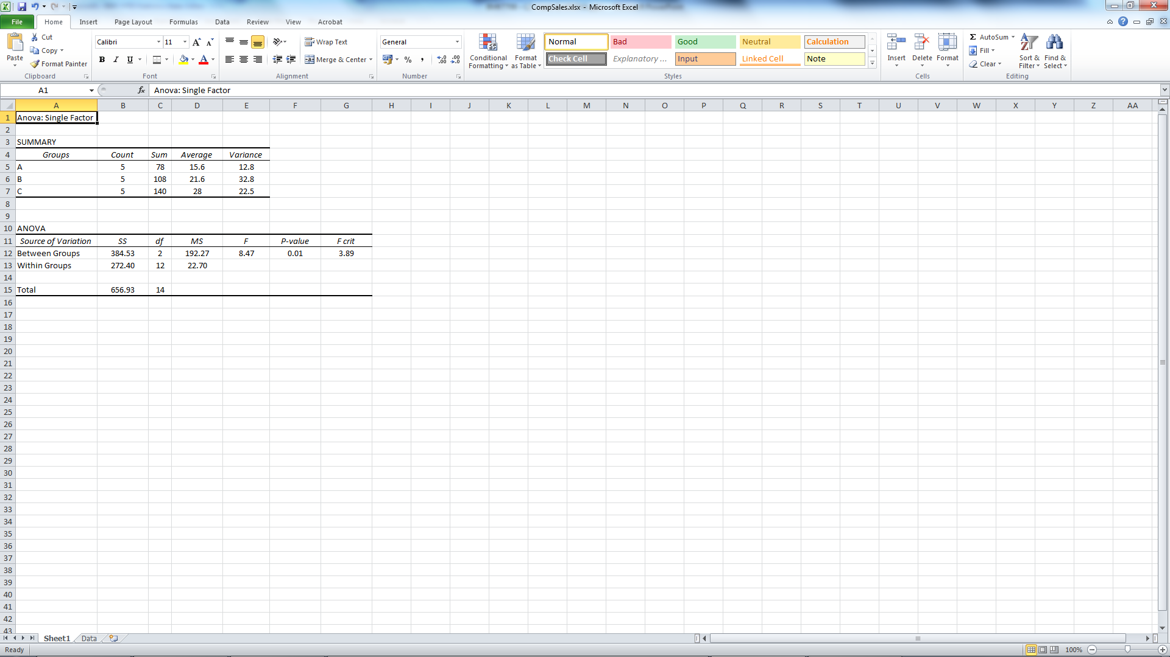
ANOVA Output
Excel
Notes:
F statistic. The null hypothesis that the category means are equal in the population is tested by an F statistic based on the ratio of mean square related to X and mean square related to error.
Mean square. This is the sum of squares divided by the appropriate degrees of freedom.

Slide 66

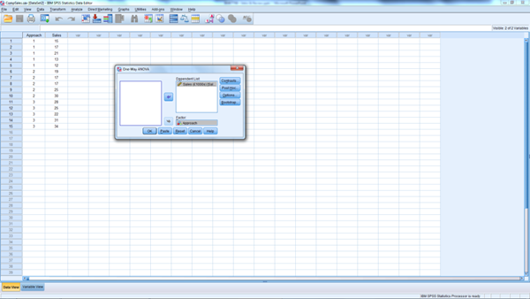
Dialog Boxes – SPSS Analy->Compare Means-> One-way ANOVA Dialog box move DV = Sales , Factor: Approach
Notes:
Analyse
Compare Means
One-way ANOVA
In dialog box:
Dependent variable: Sales
Factor: Approach

Slide 67
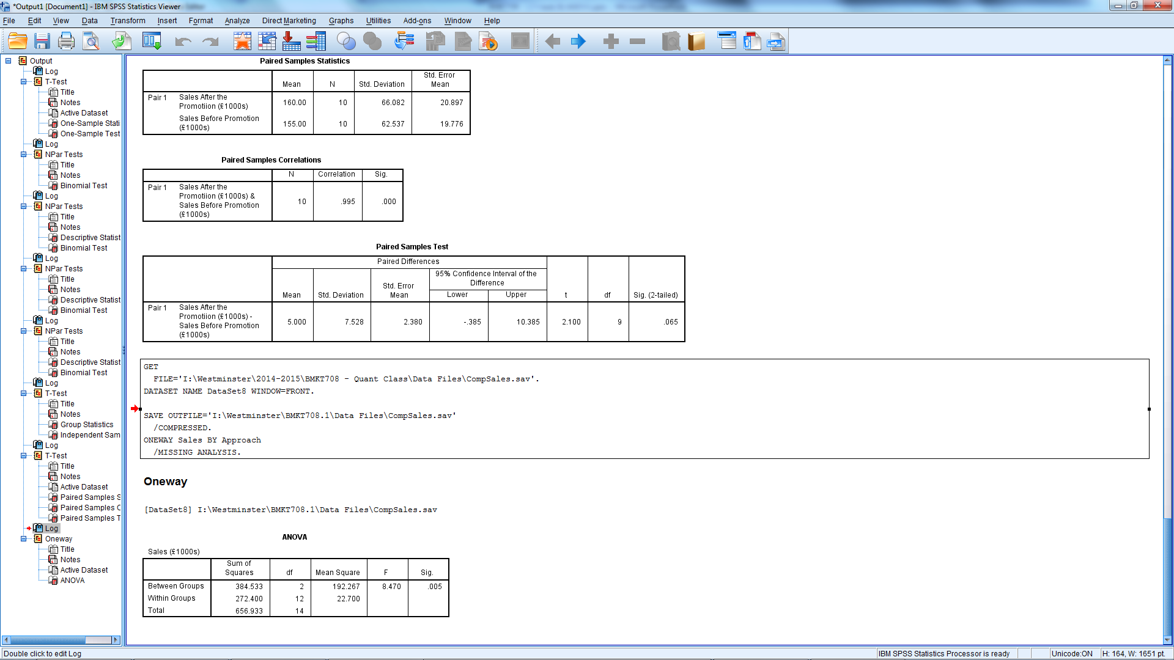
ANOVA Output
Excel
SPSS
Notes:
F statistic. The null hypothesis that the category means are equal in the population is tested by an F statistic based on the ratio of mean square related to X and mean square related to error.
Mean square. This is the sum of squares divided by the appropriate degrees of freedom.
Reject?
Yes, the at least one approach produces significantly different sales.

Slide 68
N-Way ANOVA
If two or more factors are involved, the analysis is termed n-way analysis of variance.
In SPSS: Use GLM
In Excel: Two-factor is available
Dependent variable – Metric
Independent variables:
Categorical: Factors
Metric: Covariates
Technique is called analysis of covariance (ANCOVA)
Notes:
A particular combination of factor levels, or categories, is called a treatment.
One-way analysis of variance involves only one categorical variable, or a single factor. In one-way analysis of variance, a treatment is the same as a factor level.
If two or more factors are involved, the analysis is termed n-way analysis of variance.
If the set of independent variables consists of both categorical and metric variables, the technique is called analysis of covariance (ANCOVA).
In this case, the categorical independent variables are still referred to as factors, whereas the metric-independent variables are referred to as covariates.

Slide 69
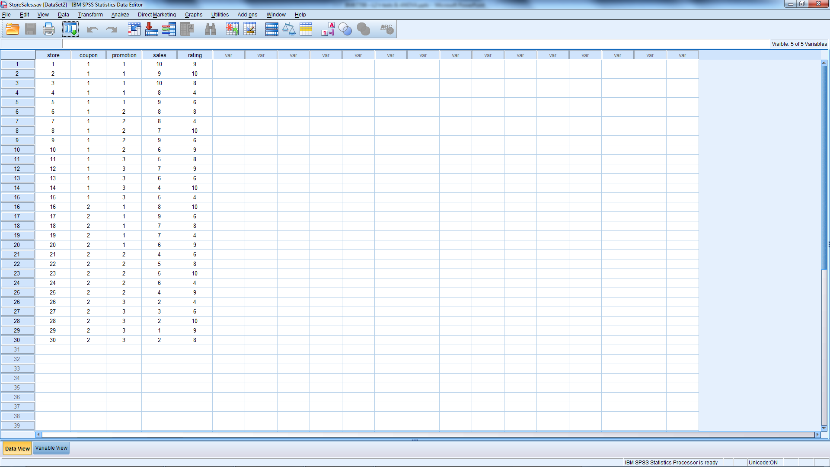
Sample Problem – StoreSales.sav

Slide 70
Summary of Hypothesis Tests
Chi-Square
t-tests
ANOVA
Compares observed frequencies to expected frequencies
Looks at differences between two groups on some variable of interest
Looks at differences between two or more groups on some variable of interest (IV has 2 or more categories)
If a significant difference exists, it doesn’t tell us which mean is different
Post-hoc Tukey test can help figure out which mean is different
Notes:
Differences of Groups
Chi Square
compares observed frequencies to expected frequencies
ex: Is there an association between gender and voting behaviour or is voting behaviour independent of gender?
t-Test
looks at differences between two groups on some variable of interest
the IV must have only two groups (male/female, undergrad/grad)
ex: Do males and females differ in the amount of hours they spend shopping in a given month?
ANOVA
tests the significance of group differences between two or more groups
the IV has two or more categories
only determines that there is a difference between groups, but doesn’t tell which is different
ex: Does purchase volume (high, medium, low) impact the level of brand switching?

